Slide 1

Galileo and the Scientific Revolution

Slide 2
The discrete optical sciences
Camera obscura, telescope, microscope
The technology (convex lenses, concave lenses, parchment, etc.) was available in antiquity.

Slide 3
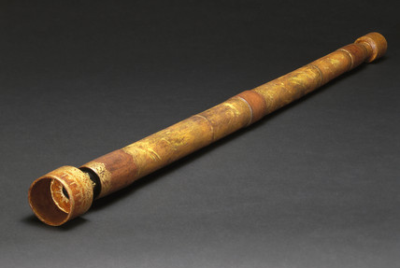
Replica of Galileo’s refracting telescope.

Slide 4
Three Sets of Observations
Galilean telescope: combination of convex and concave lenses. The refracting telescope magnifies only 21 times, but it only gives a very restricted field of view. As a result Galileo was only able to view about a third of the Moon through his telescopes. His engravings, therefore, are composites and not produced as a result of a single viewing.
Three sets of observations:
1. The spottiness of the Moon, which had been interpreted in a number of ways. Galileo observed the changing patterns of light and darkness over a number of evenings. The best explanation was that these changing patterns were shadows projected by features on the surface of the Moon; i.e., Galileo calculated that the surface features projecting these shadows were at least 4 times higher than the mountains of the Earth. Note: Mount Hadley is about the same height as Everest.

Slide 5
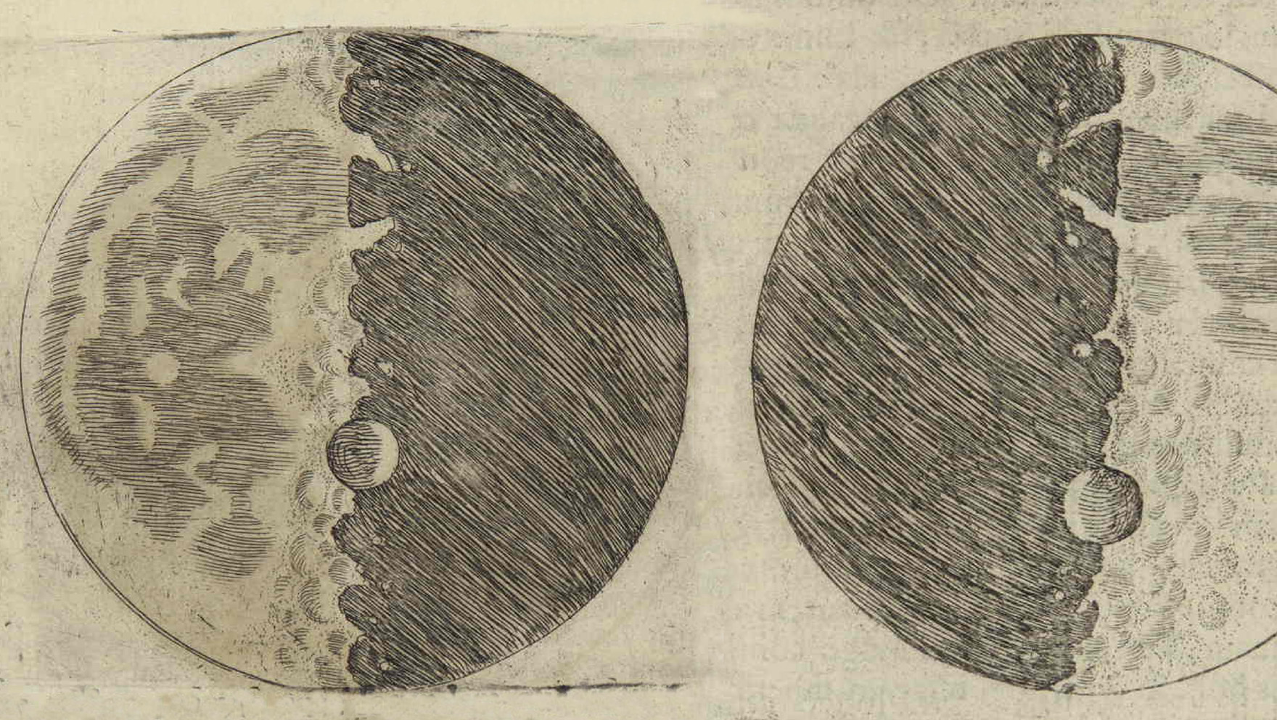
Galileo’s lunar landscapes

Slide 6
1. The Spottiness of the Moon
The spottiness of the Moon, which had been interpreted in a number of ways. Galileo observed the changing patterns of light and darkness over a number of evenings. He argued that the best explanation was that these changing patterns were shadows projected by features on the surface of the Moon; i.e., Galileo calculated that the surface features projecting these shadows were at least 4 times higher than the mountains of the Earth. Note: Mount Hadley is about the same height as Everest.
Galileo’s argument is an inference to the best explanation – namely, if it is true that the Moon is earthlike (i.e., it has valleys, mountains, etc., this will explain the changing patterns of light and darkness.

Slide 7
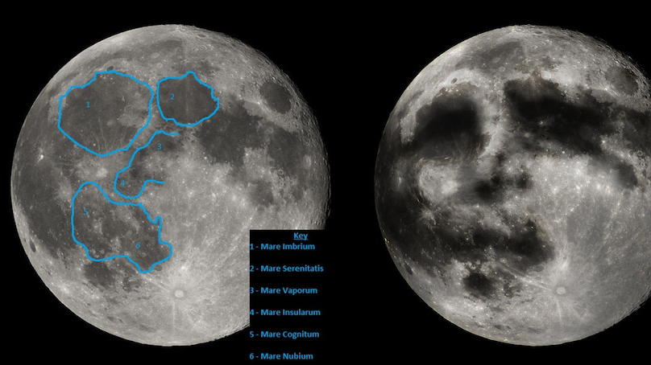
Man in the Moon

Slide 8

2. Milky Way
With Galileo’s telescope, the stars appeared brighter, but they were not enlarged and, if anything, appeared even smaller when looked at through the telescope, unlike the planets, which gave the appearance of small disks. The best explanation was that the stars were situated at immense distances from the Earth — much farther than the planets.
When Galileo then trained the telescope on the constellation Orion, he discovered and recorded many stars, never before seen with the naked eye, in the belt and in the sword of the hunter. Galileo then swung the telescope through The Milky Way, revealing that what was universally believed to be a luminous cloud in the sky was in fact a collection of individual stars.

Slide 9
3. Moons of Jupiter
Galileo observed tiny stars near Jupiter. On successive nights, he noticed that these little stars stayed with Jupiter as it wandered through the fixed stars. He concluded that these four attendants must be Moons circling Jupiter, and named them the Medicean stars, in honor of the Medici family, his patrons who ruled Tuscany.
Here was a Copernican system in miniature, which discredited the Aristotelian contention that there could only be one centre of motion in the universe — namely, the Earth. Later the same year, Galileo observed that a strange oval satellite surrounded Saturn, and that Venus exhibited phases, as the Moon did.

Slide 10
Siderius Nuncius
Published in 1610. Caused a sensation. Galileo made 8 copies of his telescope and gave them to patrons.
Kepler managed to get his hands on one of Galileo’s telescopes, though (ironically) he suffered from myopia and it is doubtful that he would have been able to witness Galileo’s observations for himself.

Slide 11
The Impact of Galileo’s observations
While the discovery of Jupiter’s satellites was perhaps the most telling blow in the debate between the old and new astronomy, the discovery that the Moon has a rugged surface was scientifically the most remarkable. The satellites of Jupiter, the rings of Saturn, the phases of Venus, and the individual stars of the Milky Way cannot be observed with the naked eye. These observations are achievements of the telescope. As a supporter of the Copernican system, Galileo was caught up with these observations because he was convinced that they only made sense if the Copernican system was true. These observations and the Copernican system, in other words, mutually vindicated one another.

Slide 12
The scientist and layperson alike did not need a Galilean telescope to know that the Moon has discernible features. It is true that the telescope enabled Galileo to study the changing patterns of these features, but to make sense of these patterns he invoked a method of argument he referred to as “in virtu di perspettiva.” Fluent in the method of representing space according to geometrical rules, elaborated by Filippo Brunelleschi (1377-1446), and the artist’s understanding of cast shadows, Galileo argued that the most plausible explanation was that the changing patterns of light and dark were caused by shadows cast by huge topographical features, including mountains and craters. The Copernican theory was consistent with the claim that the lunar surface is rugged but it did not (and count not) provide him with an interpretation for the spottiness of the Moon. It was the common language of European art that provided this interpretation.

Slide 13
Galileo and the Church
Galileo’s telescopic discoveries — and others — presented direct challenges to Aristotle’s idea of the perfection of the heavens. Some Aristotelian astronomers simply refused to look through Galileo’s telescope. Others flatly denied what he had seen. Despite the denials, the Roman Catholic Church was growing increasingly concerned. Religious objections to Copernicanism were raised for the first time in 1614 when a young Dominican, Tommaso Caccini (1574-1648), denounced Galileo officially, and the Copernican theory his observations seemed to support, from the pulpit during a sermon in the Cathedral of Florence.

Slide 14
Galileo published a letter in 1615, arguing that it would be prudent for the Church to adopt an non-literal interpretation of Joshua X.
Galileo then travelled to Rome to attempt to quell brewing thoughts about suppressing the Copernican system.
Galileo ordered only to speak hypothetically about the Copernican system. Copernicus’ work is suspended pending correction.
Galileo returned to Florence and continued his work, but now he gave more emphasis to mathematical arguments rather than to experimental or physical arguments — as the Pope wished. Galileo’s early work concentrated on arguments against Aristotle — arguments involving a sustained pattern of observation and demonstration that required little in the way of mathematics. Later, however, Galileo faced the problem of defending that theory against attacks from the Church without recourse to physical examples, as the Pope had insisted.

Slide 15
Galileo censored
Galileo published his Dialogue Concerning the Two Chief World Systems in 1632. It is unabashedly Copernican.
He was ordered to travel to Rome and to appear before the Inquisition.
His Dialogue was put on the Index. He was sentenced to life imprisonment (permanent house arrest under surveillance).Even so, Galileo, in his last years, now undertook his last and perhaps greatest work, his Discourses on the Two New Sciences, which has been described as “the cornerstone of modern physics.” It was smuggled out of Italy to France, and published in Leyden in 1638. In this book, Galileo presented the laws of accelerated motion and falling bodies, as well as the fundamental theory of projectile motion and important applications of mathematics to a host of physical problems.

Slide 16
Galilean Science
Although Galileo never worked out a satisfactory answer to this question, he carefully dismantled a number of standard objections to a moving Earth, some of which were grounded in common sense and others of which were informed by the central tenets of Aristotelian science.
Galileo found that, under ideal conditions, all bodies fall at the same rate, irrespective of differences of weight. This discovery delivered a decisive blow to Aristotelian physics, which held that the rate of fall is a function of weight (heavier bodies fall faster than light ones), and, by implication, that the Earth must fall to the center of the planetary system. Equally important, he discovered that all falling bodies obey a mathematical law of uniform acceleration: the distances traversed in intervals of time by a body falling from rest with a uniformly accelerated motion are to each other as the squares of the time intervals. This discovery marked the introduction of time as an essential component of motion, without which its mathematical analysis could not proceed. Galileo then confirmed his mathematical analysis of the acceleration of falling objects with a series of experiments with an inclined plane that allowed him to measure the rate of acceleration of objects. Conducted under actual conditions, these celebrated experimented served to verify his mathematically derived results.

Slide 17
Galileo and projectile motion
Galileo also showed that a projectile follows the path of a parabola and that its path is produced by the combination of two independent motions — a uniformly accelerated motion downward and a motion in a horizontal direction.
The uniform horizontal motion is sometimes portrayed as an anticipation of the concept of inertia that would be fully developed by Rene Descartes and Isaac Newton, but the only perpetual motion that Galileo would allow was the circular motion of the planets around the sun. In his own way, Galileo was just as enamoured with the circle as Kepler, and so perpetual motion in a circle was the only kind of inertia he could conceive. Kepler’s elliptical orbits did not square with his conception of the cosmic order and so they were rejected out of hand. Galileo’s telescopic discoveries may have signaled his rejection of the Aristotelian distinction between celestial and terrestrial physics, but in physics he held fast to the distinction between motions that are natural (i.e., uniform and circular) and motions that are unnatural or violent (i.e., accelerated and rectilinear).

Slide 18
Newton’s Inspiration?
Another development that is properly identified with Galileo was his refinement of a method of problem solving that was inspired by his admiration of Archimedes. This method involved (a) the extraction of mathematically definite concepts from the variety of physical experience; and then (b) the experimental verification of general conclusions that are drawn from these concepts through a process of mathematical deduction. The principle on which Galileo’s method was based was the conviction that once a determinate cause is established in physical theory, it is a fairly straightforward matter to tease out its physical conse­quences. The key involved defining these concepts with mathematical precision, and then following the chain of reasoning in a rigorous way. So long as there were no gaps or defects in the chain of mathematical reasoning, Galileo held that it reasonable to regard the experimental verification as a poof of the determination of the cause.

Slide 19
The Creation of the Scientific Community
With the dismantling of the medieval centralization of learning, and the trial of Galileo in Italy, scientists began to rally around the Copernican hypothesis. It is an interesting sociological fact, which is applicable here, that individuals often achieve awareness of their identity as part of a group when they feel beleaguered. Indeed, many scientists self-identified as Copernicans who toiled in fields far removed from astronomy. There are no surviving records of early gatherings in Paris, chiefly because some of the more eminent scientists were rarely seen in the capital in the 1630s and 1640s. Descartes lived in Holland, the mathematician Pierre de Fermat (1601-1665) in Toulouse, and the philosopher Pierre Gassendi (1592-1655) was often at Aix-en-Provence. Although Paris was not the physical center of French science, it did serve as the intellectual center of scientific life thanks to the efforts of Marin Mersenne (1588-1648), a member of the Catholic order of monks known as the Minims.

